Slide 1
Contemporary Moral Problems
M-F12:00-1:00, SAV 264
Instructor: Benjamin Hole
Office Hours: M-F,1-1:15
Email: bvhole@uw.edu

Slide 2

Administrative Questions
No clicker quiz
Discuss participation instead
Introduction to philosophical writing in this class
Finish Divine Command Theory
Begin Ethical Relativism

Slide 3
Week | Required Reading | Assignment
Course Mechanics, Theory Primer, and Philosophical Argumentation 6/23-6/27 | Benjamin Hole, Phil 102 Syllabus Lewis Vaughn (posted on website), “How to Read an Argument” Mark Timmons, “Moral Theory Primer” | WA1, due 6/27
Philosophical Writing and Ethical Theory 6/30-7/3 (Holiday, 7/4) | Mark B. Woodhouse (posted on website), “How to Write Philosophy” James Rachels (posted on website), “The Challenge of Cultural Relativism” Jeremy Bentham (posted on website), “The Principle of Utility” Robert Nozick, “The Experience Machine” (posted on website) | None
Ethical Theory 7/7-7/11 | J.S. Mill (electronic), On Liberty, Chapters 1-2 Immanuel Kant (posted on website), “The Moral Law” | WA2, due 7/8
Introduction to Sexual Ethics 7/14-7/18 | The Catholic Church, “Vatican Declaration on Some Questions in Sexual Ethics” John Corvino, “A Defense of Homosexuality” Thomas Mappes, “A Liberal View of Sexual Morality and the concept of Using Another Person” | None
Introduction to International Ethics 7/21-7/25 | Peter Singer, “Famine, Affluence, and Morality” (posted on website) Garrett Hardin, “Lifeboat Ethics” (posted on website) | WA3, due 7/22
Introduction to Social and Political Ethics: Censorship and Pornography 7/28-8/1 | Ronald Dworkin, “Liberty and Pornography” Judith M. Hill, “Pornography and Degradation” Catharine MacKinnon (posted on website), “Pornography, Civil Rights, and Speech” | None
Abortion 8/4-8/8 | Pope John Paul II, “The Unspeakable Crime of Abortion” Mary Anne Warren, “On the Moral and Legal Status of Abortion” Don Marquis, “Why Abortion Is Immoral” | WA4, due 8/5
Conference for Final Papers 8/11-8/15 | Catch-up if we’ve fallen behind. Conference for Final Papers: presentations and discussion | None
Abortion 8/18-8/22 | Judith Jarvis Thomson, “A Defense of Abortion” Rosalind Hursthouse, “Virtue Ethics and Abortion” | WA5, due 8/19 Final Paper, due 8/21

Slide 4
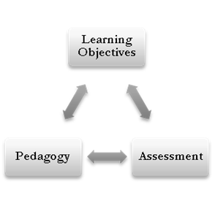

Slide 5
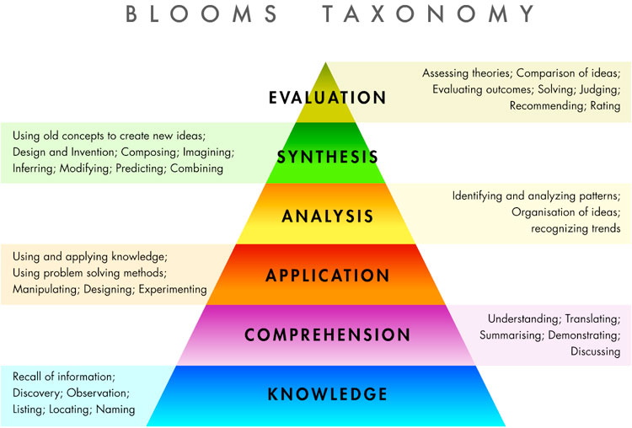

Slide 6
Participation Strategies
Open-ended questions are not “yes or no” questions. These are often fact-gathering questions to gain more knowledge about philosophical content or methodology.
Philosophical and academic conventions questions are leading questions to new conclusions or understanding.
You can ask clarifying questions from the perspective of the engaged reader, asking to clear up certain elements of her argument/organization.
Questions to encourage depth of thought or point out faulty logic. This is your primary opportunity to apply philosophical skills. (See learning goals for fuller description.)
Follow-up questions allow you to “check in” with to make sure you understand the content and relevant skills. This is also an opportunity to make sure you understand in such a way that you can apply the same content and skills to new contexts.

Slide 7

Introduction to Philosophical Writing

Slide 8
I am comfortable with philosophical writing
Strongly Agree
Agree
Somewhat Agree
Neutral
Somewhat Disagree
Disagree
Strongly Disagree

Slide 9
Writing Resources
Jim Pryor’s Guidelines on Writing a Philosophy Paper (link)
Mark Woodhouse’s Writing Philosophy (POSTED)
The Odegaard Writing and Research Center (link): “This is the place to come and chat with peer tutors and librarians, to grow as a writer in the context of whatever project is foremost in your mind.”
The UNC Writing Center’s Handouts (link): for general writing help.

Slide 10
Philosophical Writing in PHIL 102
http://writingcenter.unc.edu/handouts/understanding-assignments-demo/
Writing Assignments (25%)
The point of the weekly writing assignments is to serve as lower stakes opportunities for assessment and to provide you with practice of the philosophical skills you will need to master for the final paper.
Final Paper (35%)
The point of the paper is for you to demonstrate that you are familiar with a major view in ethical theory and are able to critically evaluate that view with philosophical rigor. Your critical evaluation is an opportunity for you to demonstrate your mastery of the philosophical skills you have practiced throughout the quarter.
Interpretation and Analysis: be able to analyze, interpret, and understand philosophical texts and discourse.
Argumentation: be able to effectively identify, evaluate, and formulate arguments.
Philosophical Knowledge and Methodology: be able to demonstrate a high degree of fluency with the major traditions, figures, concepts, and methods of philosophy.
Communication: be able to develop, organize, and express ideas in a precise, clear, effective, and systematic manner in writing and discussion.

Slide 11
Final paper
The assignment is to write an argumentative paper. You are expected to argue against one of the arguments or views (from the course material). You are also expected to consider, and respond to, one powerful objection to your argument. You may choose the argument yourself; if you have any questions about whether a particular topic is worth writing on, please ask me beforehand.

Slide 12
Final paper

Slide 13
Woodhouse, “How to Write Philosophy”
formulating the problem
deciding on a format
incorporating other philosophers’ views
presenting a good introduction
http://writingcenter.unc.edu/handouts/introductions/
achieving coherence
achieving clarity
clearly expressing your ideas
using examples
writing well
http://writingcenter.unc.edu/handouts/
http://depts.washington.edu/owrc/

Slide 14
Be as complete and precise as possible
Revise at least 3-4 drafts.
Eliminate all superfluous language;
use very clear and simple language.
Use examples.
http://www.youtube.com/watch?v=iVt1WmPwL2I

Slide 15
Common Problems
Unclear argumentative structure
Failure to understand the text or assignment
Proof-reading errors
Superfluous language
Excessive verbiage
Excessive adjectives/adverbs
2-line/2-clause limit
Paragraph structure
Sentence structure
Vague thesis statements
Passive voice / awkward locutions
http://writingcenter.unc.edu/handouts/

Slide 16
Citations & Plagiarism
Citations. Every descriptive claim about course material must be cited. Failure to cite such claims is a kind of plagiarism.
“Plagiarism is defined as the use of creations, ideas or words of publicly available work without formally acknowledging the author or source through appropriate use of quotation marks, references, and the like. Plagiarizing is presenting someone else’s work as one’s own original work or thought. This constitutes plagiarism whether it is intentional or unintentional. The University of Washington takes plagiarism very seriously. Plagiarism may lead to disciplinary action by the University against the student who submitted the work. Any student who is uncertain whether his or her use of the work of others constitutes plagiarism should consult the course instructor for guidance before formally submitting the course work involved.”
(Sources: UW Graduate School Style Manual; UW Bothell Catalog; UW Student Conduct Code)

Slide 17
I am comfortable with philosophical writing
Strongly Agree
Agree
Somewhat Agree
Neutral
Somewhat Disagree
Disagree
Strongly Disagree

Slide 18
Overview
“Six Essential”
Theories
Ethics by Authority
Consequentialism
Kantian Ethics
Natural Law Theory
Rights Based Moral Theory
Virtue Ethics
Prima Facie Duties
Divine Command Theory
Ethical Relativism

Slide 19
The Euthyphro Dilemma
Divine Command Theory: An act is right iff (and because) God commands it.
The Dilemma: Either it right because God commands it or God command it because it is right.
Horn One: If it is right because God commands it, then there is no basis for the word of God.
Horn Two: If God commands it because it is right, then there is some standard for rightness besides the word of God.

Slide 20
Discussion Questions
Which option is better?
If it is right because God commands it, then there is no basis for the word of God.
If God commands it because it is right, then there is some standard for rightness besides the word of God.
Is there a way out of the Euthyphro dilemma for DCT?

Slide 21
Which option is better?
If it is right because God commands it, then there is no basis for the word of God.
If God commands it because it is right, then there is some standard for rightness besides the word of God.

Slide 22
DCT can avoid the Euthyphro dilemma.
True
False

Slide 23

Ethical Relativism
(ER) “An act (performed by members of group G) is right if and only if the moral norms that are accepted by G permit the performance of the action.”

Slide 24
Cultural Differences Argument
Different cultures have different moral codes.
Therefore, there is no objective "truth" in morality. Right and wrong are only matters of opinion, and opinions vary from culture to culture.

